Slide 1
MED VANTAGE
NAME | ID
Md. Maruf Raihan | 011201196
Muztoba Rafid | 011192103
Tahmidul Rahman Saad | 011192019
Md. Habibur Rahman Alhadi | 011192084
Nayeem Muhammad Al Farabi Sikder | 011201269

Slide 2
INTRODUCTION
We envision an online platform from where accessing mental health support will be easy for all people in Bangladesh. Users can easily book appointments, pay online, and talk to qualified psychologists with ease and safety. We believe this will help bring down the stigma associated with mental health, allowing people to be more open about the issue and access the necessary care and treatment.

Slide 3
OBJECTIVES
Build an Online Mental Healthcare Platform
Ensure Professional Verification
Simplify Appointment Scheduling
Implement a Secure Payment System
Boost Accessibility

Slide 4
BACKGROUND OF THE STUDY MOTIVATION
Support for Rural Communities.
Connect with Qualified Professionals.
Streamlined Appointment Scheduling
Secure Payment Processes
Promote Mental Health Awareness
Enhance Accessibility
Continuous Improvement
Collaborate with Experts

Slide 5
BENCHMARK ANALYSIS
FEATURES | MED VANTAGE | MONERBONDHU.COM ✘ | DOCTORONDEMAND | ESHO NIJE KORI
User-Friendly Design | ✔ | ✔ | ✔ | ✔
Professional Verification | ✔ | ✔ | ✔ | ✔
Appointment Booking | ✔ | ✔ | ✔ | ✘
Secure Payments | ✔ | ✘ | ✔ | ✘
Feedback System | ✔ | ✘ | ✘ | ✘
Analytics and Reporting | ✔ | ✘ | ✘ | ✘

Slide 6
FEATURES
USER / PATIENT
See Doctor list
Book appointment
Make Payment
Give Review
ASSISTANT
See Patient request
Confirmed patient request
DOCTOR
See Patient list
Confirmed Appointment list
Provide Meeting Link
Check Patient Document
Check Review
ADMIN
Add or Remove Doctor
Make Admin or Remove

Slide 7
FLOW CHART

Slide 8
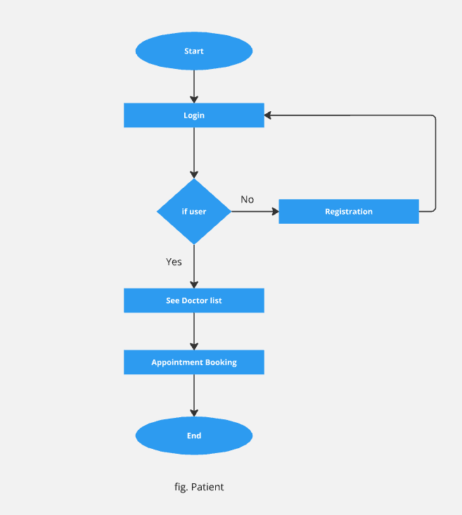
PATIENT

Slide 9
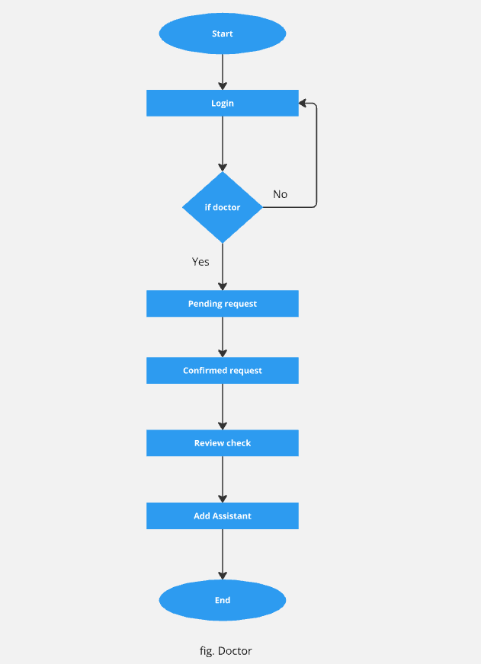
DOCTOR

Slide 10
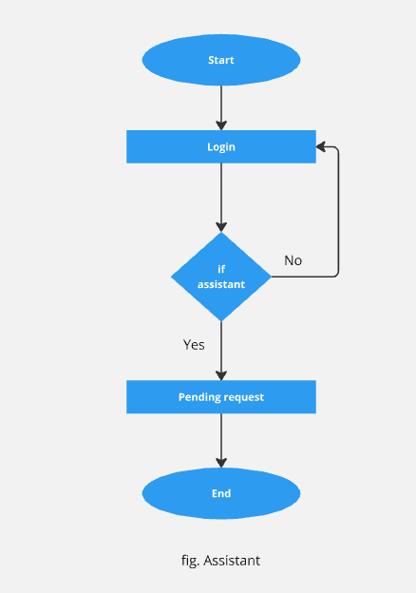
ASSISTANT

Slide 11
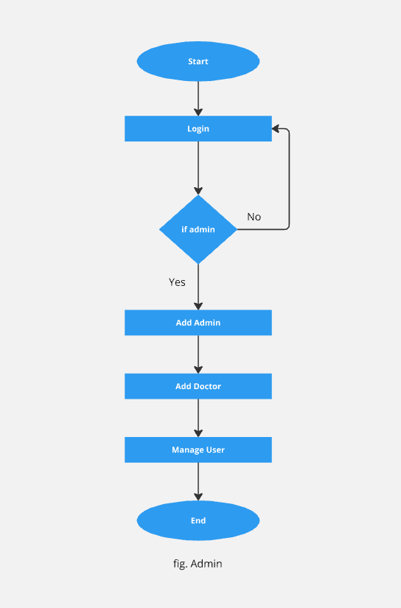
ADMIN

Slide 12
SURVEY

Slide 13
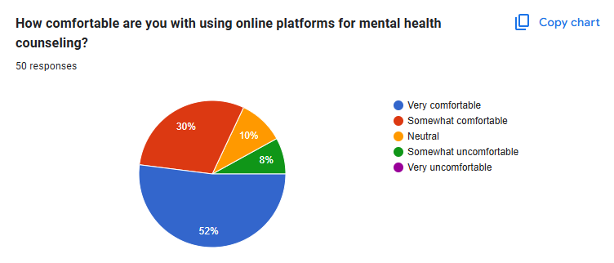

Slide 14
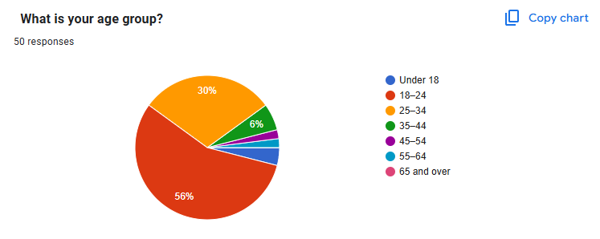

Slide 15
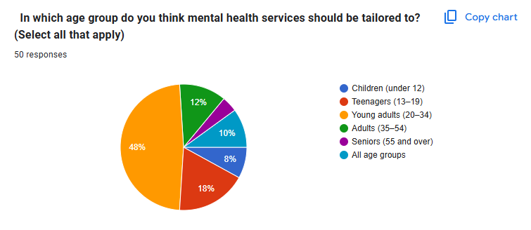

Slide 16
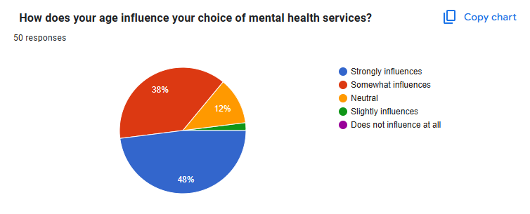

Slide 17
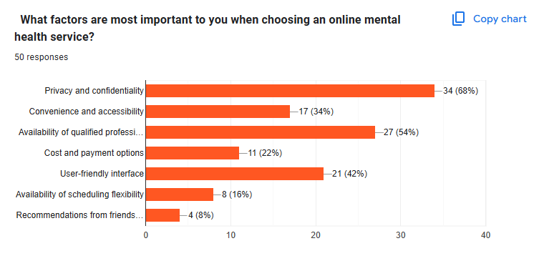

Slide 18
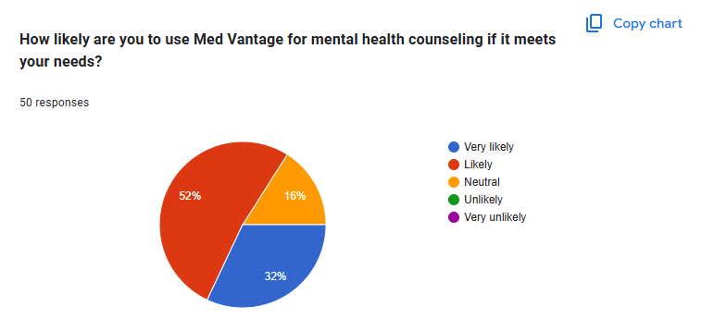

Slide 19
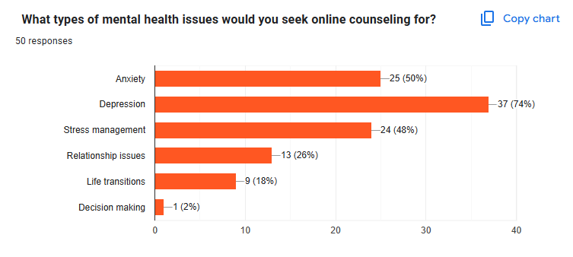

Slide 20
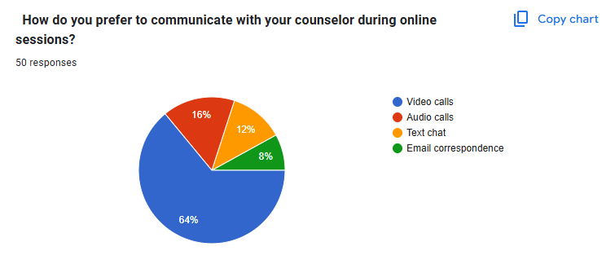

Slide 21
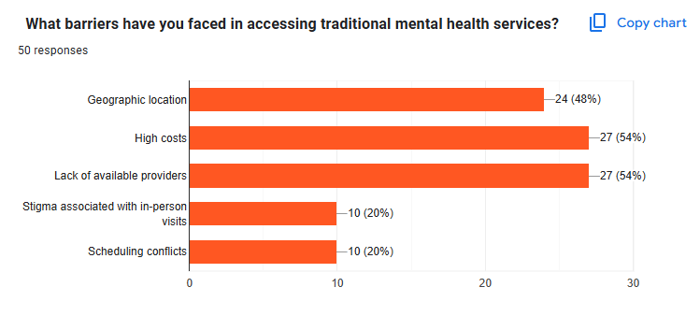

Slide 22
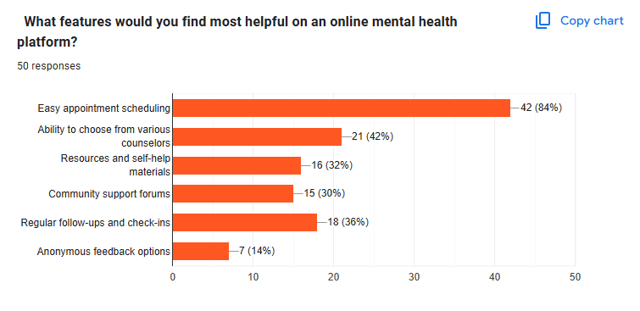

Slide 23
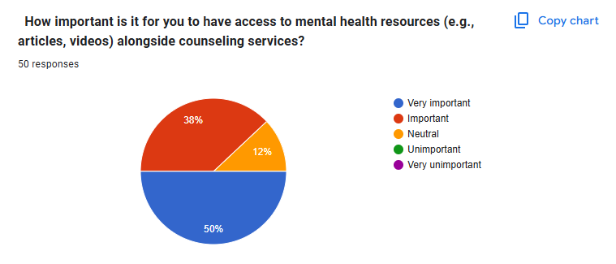

Slide 24
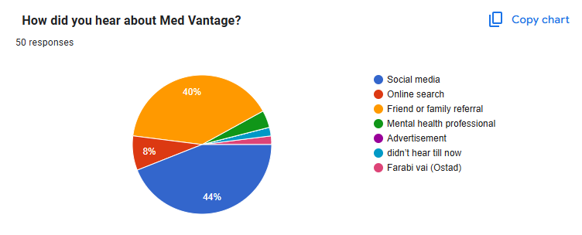

Slide 25
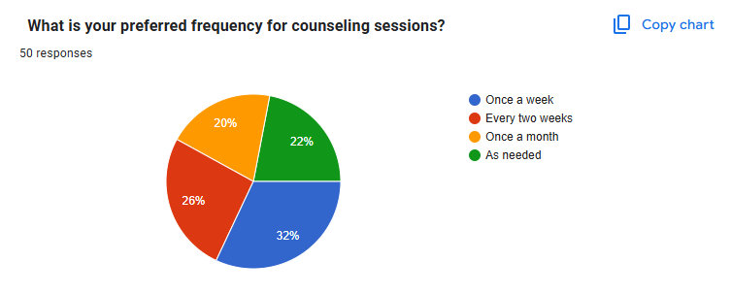

Slide 26
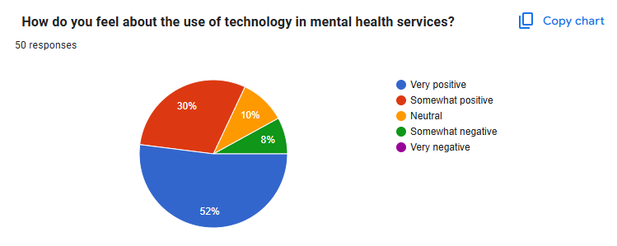

Slide 27
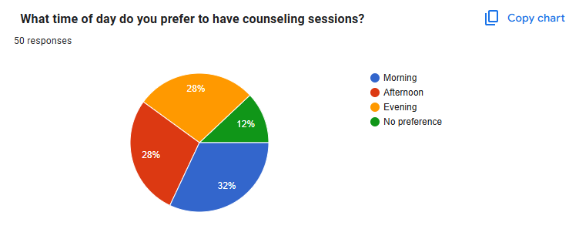

Slide 28
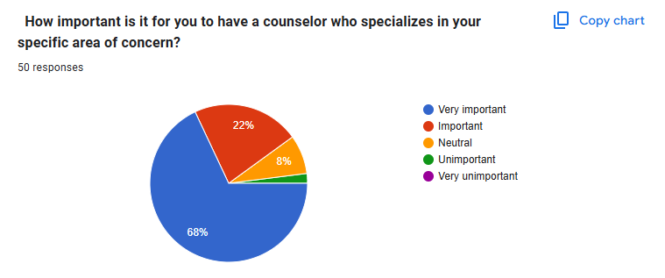

Slide 29
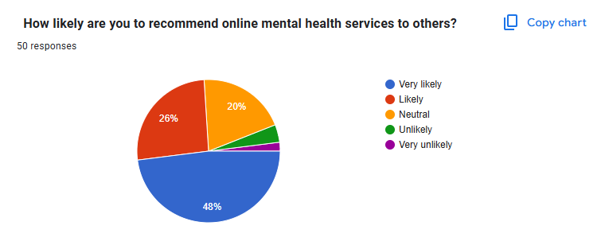

Slide 30
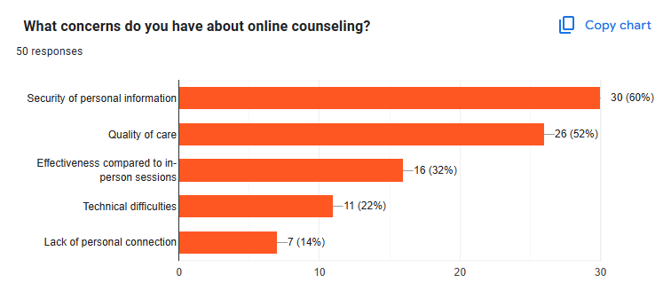

Slide 31
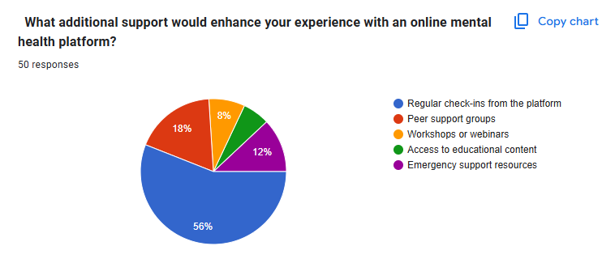

Slide 32
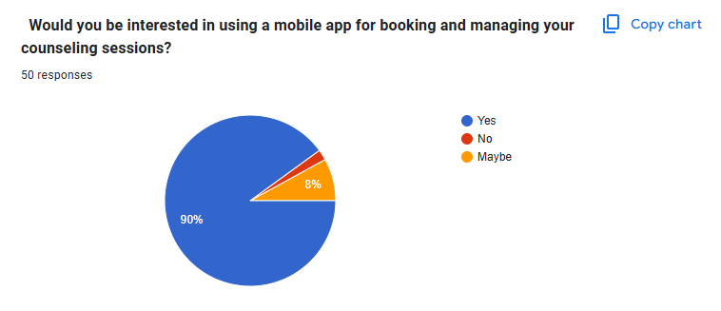

Slide 33
COMPLEX ENGINEERING PROBLEMS

Slide 34
P1(Depth of knowledge required):
K1–natural sciences
K2 –mathematics
K3 –engineering fundamentals
K4 –specialist knowledge
K5 –engineering design
K6 –engineering practice
K7 –comprehension
K8 –research literature
* existing models with similar goals (k8)
* Data collection And ML design (k3, k4)
* Design and Implementation (k5, k6)
* data collection from user studies, survey (K7)
P2 (Conflicting technical requirements):
Build a Machine Learning model with low variance but primarily, we have no data.

Slide 35
P3(Depth of analysis required ):
K1–natural sciences
K2 –mathematics
K3 –engineering fundamentals
K4 –specialist knowledge
K5 –engineering design
K6 –engineering practice
K7 –comprehension
K8 –research literature
* Select a specific machine learning algorithm from many alternatives
* Select specific data from the feedback report analysis.
P4( Familiarity of issues):
* we are not so much familiar with mental health problems

Slide 36
P7(Interdependence):
K1–natural sciences
K2 –mathematics
K3 –engineering fundamentals
K4 –specialist knowledge
K5 –engineering design
K6 –engineering practice
K7 –comprehension
K8 –research literature
P5(Extent of applicable codes):
* Maintain ethical standards
* Need permission before using patient data
P6( Extent of stakeholder involvement & conflicting requirements):
* Different stakeholders may have different needs.
* project has many interdependent sub sections.

Slide 37
LANGUAGE
Html 5
CSS
Bootstrap 5
JAVASCRIPT
DJANGO

Slide 38
CONCLUSION
The online platform helps people in Bangladesh get mental health support easily. It connects them with qualified mental health professionals, makes scheduling and payments simple, and aims to improve mental health for everyone.

